Slide 1


Microsoft Copilot Studio | Employee Self-Service Agent
ESS Insights Dashboard
Interpretation Guide
Get the template and docs at https://github.com/microsoft/ESS
Last updated 8/19/26
The content in this interpretation guide is intended solely to help you better understand the ESS Insights dashboard and the questions it can answer. All figures shown are generated from demo data; once you connect your own Copilot Studio agent, your insights may look materially different.

Slide 2
The three numbers that matter
If you read nothing else in this guide, read this. Three numbers tell the whole story — everything else in this deck explains and defends them.
REACH — Conversations and Conversation Users
How many employees actually used the agent, and how often they came back. Open: Executive Summary, then Adoption.
EFFECTIVENESS — Resolution Rate
The share of real conversations the agent resolved with no human help. This is the proof the agent works. Open: Conversation Outcomes.
VALUE — Net Value and Annualized Value
Hours saved converted to dollars, net of agent cost, using assumptions you control. Open: Business Impact.
Read leading indicators (quality, adoption, productivity) weekly; read lagging indicators (operational KPIs, business outcomes) monthly. Do not judge ROI in week one.

Slide 3
Introduction
This guide walks through the ESS Insights dashboard page by page and, for each page, explains what the visuals mean and — more importantly — what to do with them. It is written from a consultant's point of view: every metric is paired with an interpretation and a concrete recommendation so you can turn the numbers into action, not just read them. Every page also displays a data-window caption (“Data window: <start> – <end> • N users, N conversations”) — every figure you see is scoped to that window, so always check it before comparing numbers across pages or over time.
Detailed Slide Interpretation
For each dashboard page you'll find the page recreated with numbered markers. Each number maps to a callout that poses the key business question, interprets what the data is telling you, and recommends a next step. Follow the numbers in order to read the page the way a consultant would.
Questions?
Reach out to your deployment team or open an issue on the ESS Insights repository.

Slide 4
Why the conversation count is smaller than the visit count — and why that is correct
Every record in the transcript export is an agent VISIT. The report classifies every visit into one of three types before it reaches any rate or ROI figure.
The three visit types
• Conversation — a real user turn. This is the basis for every rate, topic and ROI figure.
• Agent Error — the platform failed before a real exchange. A reliability signal, not a content one.
• Visits, no interaction — the agent initialized but nothing was exchanged. Reach, not engagement.
Why rates use Conversations only
Initialization records carry no question, so including them would dilute every rate by an order of magnitude and no topic could be derived from them. A smaller, honest denominator is the defensible one.
Total Agent Visits is still available as the raw record count. If reach looks large but conversations look small, that is an engagement question. If Agent Errors are large, that is a reliability question — different problem, different owner.

Slide 5
How to Read This Report
This section gives you a strategic reading order for the eight detailed pages that follow. Read them in this sequence to build a consultant's narrative — from business outcome, to scale of adoption, to quality diagnosis, to your next action — rather than the file order they happen to appear in.
The Consultant's Reading Order
1. Business Impact — start here. Is the agent worth it in hours and dollars? This is the headline number every executive asks for first.
2. Executive Summary — ESS Business Value Realization — confirms the trend is real, not a one-time spike, and shows whether leading indicators support the lagging ROI number.
3. Organization Adoption — establishes scale. A strong ROI on a handful of users is a different story than the same ROI at enterprise scale.
4. Conversation Outcomes and Agent Feedback — the quality layer. These pages explain WHY the numbers above look the way they do: is the agent actually resolving requests, and do users trust the answers?
5. Time to Knowledge and Conversation Details — the evidence layer, for when you need to defend a number or understand a specific topic in depth.
Finish on Fix-It Queue — it is deliberately last. It is the backlog: the concrete list of what to fix next, informed by everything you just read.
Three Questions to Ask at Every Review
Is the trend improving or flat? Is adoption broad or concentrated in a few teams? Does the improvement backlog shrink release over release, or just get longer? If you can answer these three from the pages above, you have everything you need for an executive readout.

Slide 6
Frequently Asked Questions
Q: What is the ESS Insights dashboard?
A: A Power BI template that turns Copilot Studio conversation data from your Employee Self-Service agent into adoption, effectiveness, sentiment, and ROI insight — all in one place.
Q: Where does the data come from?
A: From your Copilot Studio agent's conversation transcripts and analytics. The template ships with demo data so you can explore every page before connecting your own agent.
Q: The numbers look different from mine. Why?
A: Every figure in this guide is demo data. Once you connect your own agent, the values, trends, and topic lists will reflect your organization.
Q: How often should I review it?
A: Review leading indicators (adoption, quality, sentiment) weekly and lagging indicators (ROI, business outcomes) monthly. Use the Executive Summary page to open steering meetings.
Q: What should I do when a metric looks bad?
A: Every detailed page ends with recommendations. Persistent problems flow into the Fix-It Queue page, which turns weak metrics into a prioritized content backlog with owners.

Slide 7
Glossary
Total Conversations: Legacy measure — do not use for reporting. It counts ALL agent visits, including initializations with no user interaction. The correct metric for conversation-level reporting is "Conversations" (see below).
Abandonment Rate: Share of conversations the user left before reaching a resolution.
Total Users: Number of unique people who engaged the agent.
Zero-Result Rate: Share of conversations where the agent returned no usable answer.
Sessions per User: Average conversations per user; a basic stickiness measure.
Turns to Resolve: Average number of back-and-forth exchanges per conversation.
Repeat Usage Rate: Share of users who returned for more than one conversation.
Thumbs-Up Rate: Share of feedback responses that were positive.
DAU / WAU / MAU: Average Daily / Weekly / Monthly Active Users.
CSAT: Customer satisfaction score (1–5) from post-conversation feedback.
Resolution Rate: Share of conversations the agent resolved with no human help. The headline effectiveness metric.
Hours Saved / Tickets Deflected: Estimated human effort avoided, based on the assumptions on the Business Impact page.
Engaged Rate: Share of conversations where the user actively interacted vs. abandoning.
Leading vs. Lagging Indicators: Leading metrics (quality, adoption, productivity) move first and predict value; lagging metrics (operational KPIs, business outcomes) confirm realized impact.

Slide 8
Glossary (continued)
Agent Visit: One session record in the transcript export, whether or not a user interacted.
Native vs Derived topic: Native means the agent reported the topic itself; Derived means the report inferred it from the user's first message. Generative agents produce mostly Derived topics.
Conversation: A visit with genuine user engagement. The basis for all rates, topics and ROI.
Root Cause: The plain-language reason a Fix-It Queue row was flagged.
Agent Error: A visit where the platform failed before a real exchange.
Gap Type: Content Gap (agent failed) or Authoring Gap (agent helped, no native topic).
Visits, no interaction: The agent initialized but no messages were exchanged.
Annualized Value: The selected window's value extrapolated to 52 weeks. Directional in a short pilot.
Topic Coverage %: Share of conversations whose topic was classified rather than left uncategorized.

Slide 9
What "good" looks like — read every metric against a band
Metric | Watch | Healthy | Interpretation if below
Resolution Rate | < 60% | 70%+ | Content or knowledge gaps; work the Fix-It Queue
Repeat Usage Rate | < 30% | 40%+ | Trust or relevance problem; fix before scaling licenses
Abandonment Rate | > 20% | < 15% | Users hitting friction; check Time to Knowledge
Topic Coverage % | < 70% | 85%+ | Many questions unclassified; extend the topic taxonomy
Agent Error Rate | > 10% | < 5% | Platform reliability issue — escalate to the agent owner
Bands are orientation, not policy. Set your own 30/60/90-day targets and hold the same definition each period.

Slide 10
Your first 30 days with this report
Week 1 — Confirm the data.
Load your export, check the data-window caption, read the visit mix (Conversations vs Agent Errors vs no-interaction). Do not present numbers yet.
Week 2 — Set the assumptions.
Replace the default minutes and hourly rate using the Topic to Time Savings method, and have finance sign off once.
Week 3 — Work the Fix-It Queue.
Take the top three Content Gaps, assign owners, fix the content.
Week 4 — Present.
Open with the Executive Summary and the three numbers that matter.

Slide 11

Detailed Slide Interpretation
🔍

Slide 12
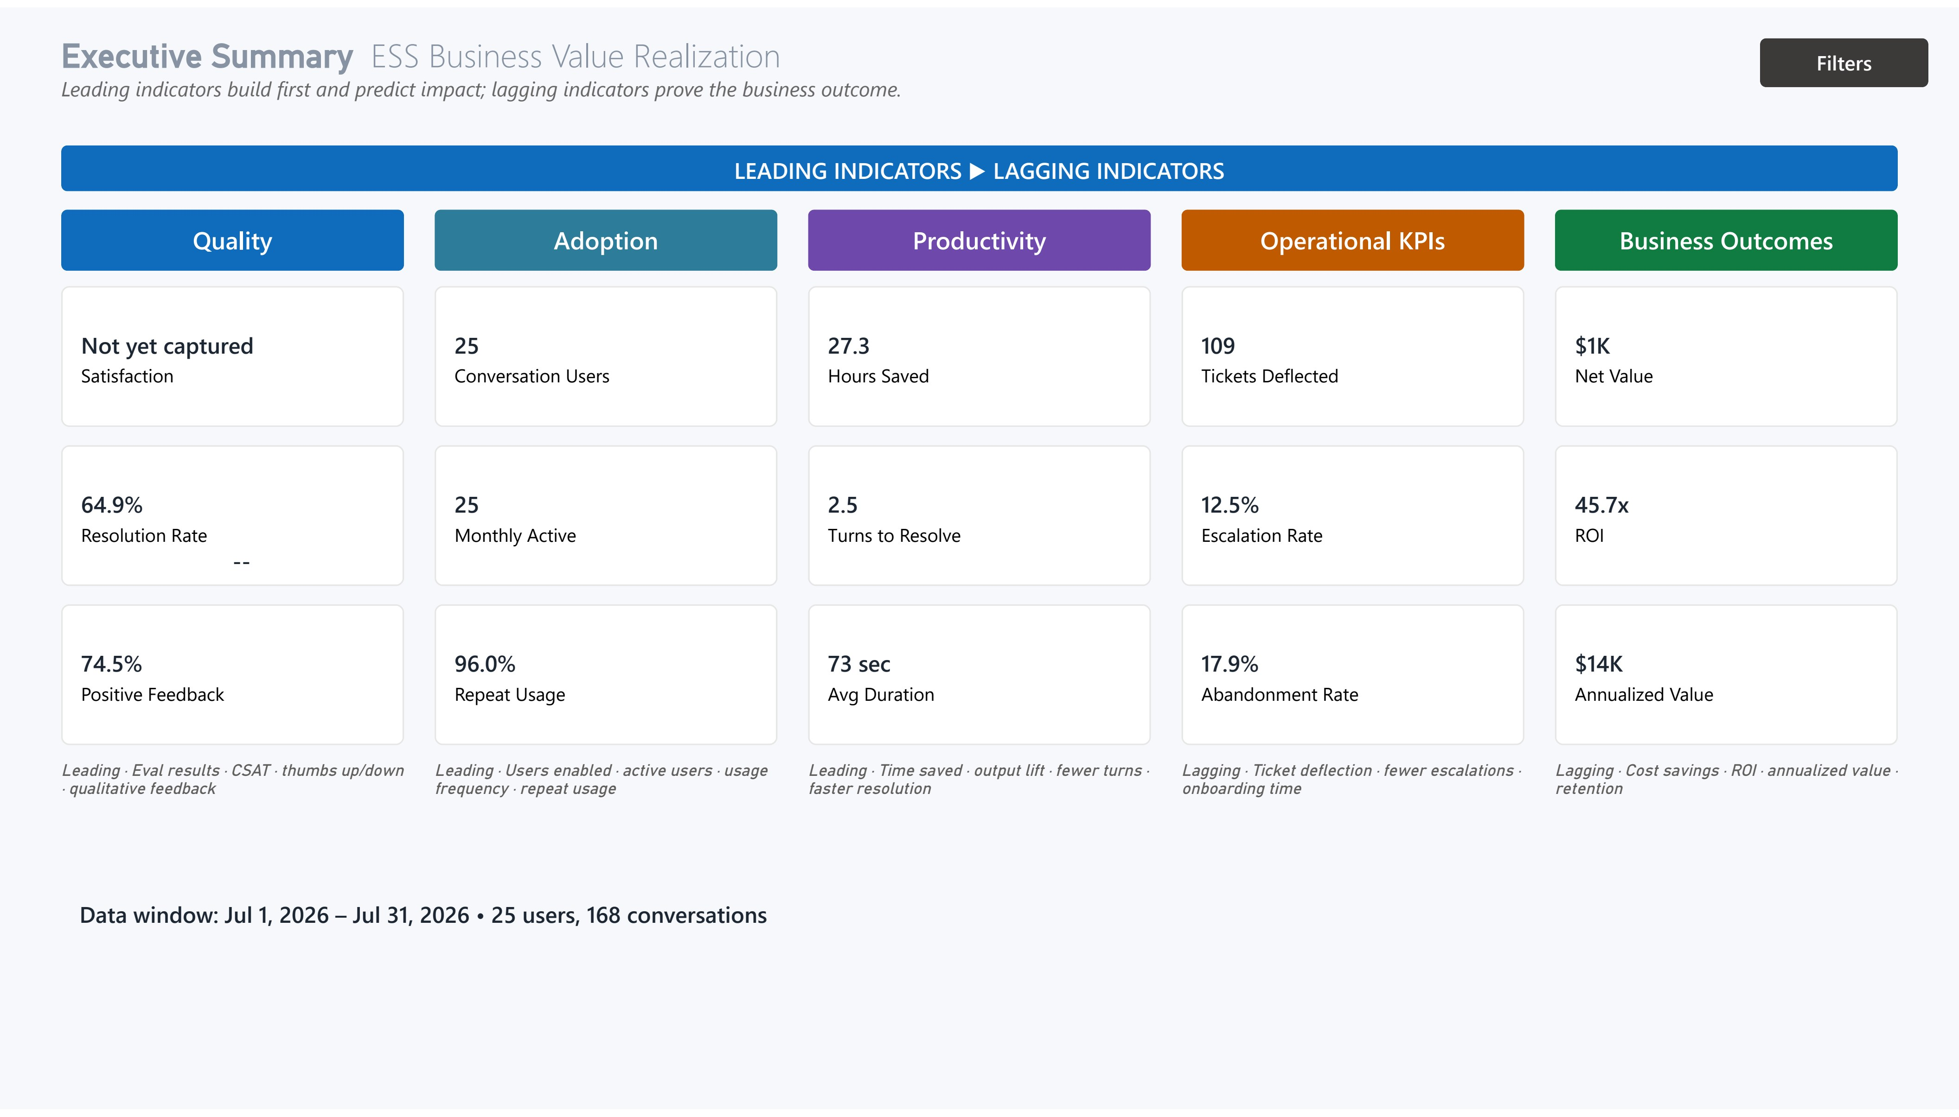
Executive Summary ESS Business Value Realization
1
Why are indicators split into leading and lagging?
INTERPRETATION: Leading indicators (Quality, Adoption, Productivity) move first and predict value; lagging indicators (Operational KPIs, Business Outcomes) confirm the dollars-and-hours impact weeks later.
GUIDANCE: Read the page left-to-right. Early in a rollout expect the left columns to move while the right lag — don't judge ROI in week one.
1
2
3
2
Are the leading indicators healthy?
INTERPRETATION: Quality, Adoption and Productivity are the earliest proof the agent works. They should trend up before you expect business outcomes.
RECOMMENDATION: Set 30/60/90-day targets for each. If adoption or quality stalls, act on Improvement Opportunities before expecting ROI to appear.
4
3
4
When can I credibly claim business value?
INTERPRETATION: Operational KPIs and Business Outcomes are the CFO-grade numbers. They only stabilize once adoption is steady and volume is meaningful.
RECOMMENDATION: Report lagging value monthly, not weekly, and pair every ROI figure with the assumptions on the Business Impact page for finance to validate.
What belongs here vs. in Copilot Studio?
INTERPRETATION: This is the executive scorecard — the single view for leadership. Operational troubleshooting and content fixes live in Copilot Studio, not on this page.
GUIDANCE: Open every steering meeting with this page; do the actual fix work between meetings in Improvement Opportunities and Copilot Studio.

Slide 13
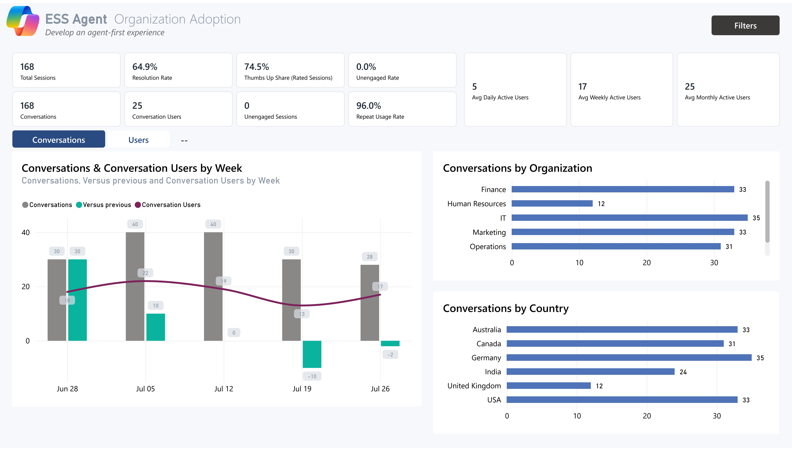
Organization Adoption Develop an agent-first experience
1
Is the agent gaining real, repeat users — not one-time curiosity?
INTERPRETATION: A healthy-looking user and conversation count is not proof of adoption by itself — Repeat Usage Rate and Sessions per User are what prove the agent earned a second visit.
RECOMMENDATION: Treat repeat usage as your north-star adoption metric. Below ~30% signals a trust or relevance problem — fix it before scaling licenses.
1
2
2
3
Is adoption growing, plateauing, or decaying?
INTERPRETATION: The weekly trend shows the shape of adoption. A rise-then-plateau is normal after launch; a sustained decline means novelty wore off.
GUIDANCE: Watch the gap between conversations and users. Conversations growing faster than users means your base is getting more value per person.
4
3
4
Which departments have adopted — and which haven't?
INTERPRETATION: Users by Organization exposes strength and whitespace. A near-empty department is usually an enablement gap, not disinterest.
RECOMMENDATION: Target bottom-quartile departments with a champion, a use-case demo and a nudge campaign. Adoption spreads fastest team-by-team.
Is usage global or concentrated?
INTERPRETATION: Users by Country reveals geographic reach and any language or timezone barriers. Balanced bars suggest the agent generalizes well.
GUIDANCE: If one region lags disproportionately, check language coverage and localized content before assuming there is simply low demand.

Slide 14
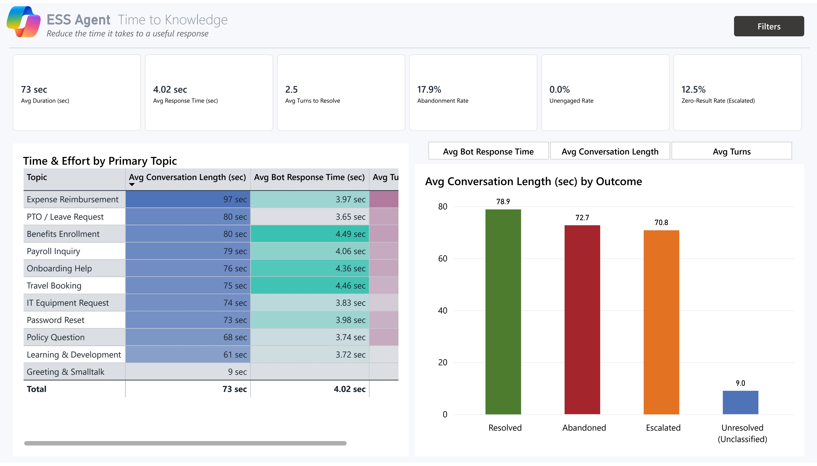
Time to Knowledge How fast users reach an answer
1
How quickly does the agent get people to an answer?
INTERPRETATION: Avg Response Time (13.4s), Duration (57s) and low turns (1.6) mean users get what they need fast — the core promise of self-service.
RECOMMENDATION: Benchmark against your old channel. The consultant story is 'X minutes → under a minute,' and that delta justifies the investment.
1
2
2
4
Where are users giving up?
INTERPRETATION: Abandonment (17.7%), Unengaged (20.4%) and Zero-Result (3.7%) are your friction signals — users who hit a wall and left without an answer.
RECOMMENDATION: Set ceilings (e.g. abandonment <15%, zero-result <5%). Anything above feeds straight into the Improvement Opportunities backlog.
3
3
4
Which topics cost the most effort?
INTERPRETATION: Time & Effort by Primary Topic ranks topics by duration and turns. High turns plus long duration means complex or poorly-supported content.
GUIDANCE: Sort by effort and fix the top three topics first. Small content improvements there move the whole-page averages.
Does faster always mean better?
INTERPRETATION: Metrics by Session Outcome split speed by result. Fast-but-failed conversations are a red flag — the agent ended quickly because it couldn't help.
RECOMMENDATION: Always read speed together with outcome. Optimize for fast and resolved, never speed alone.

Slide 15
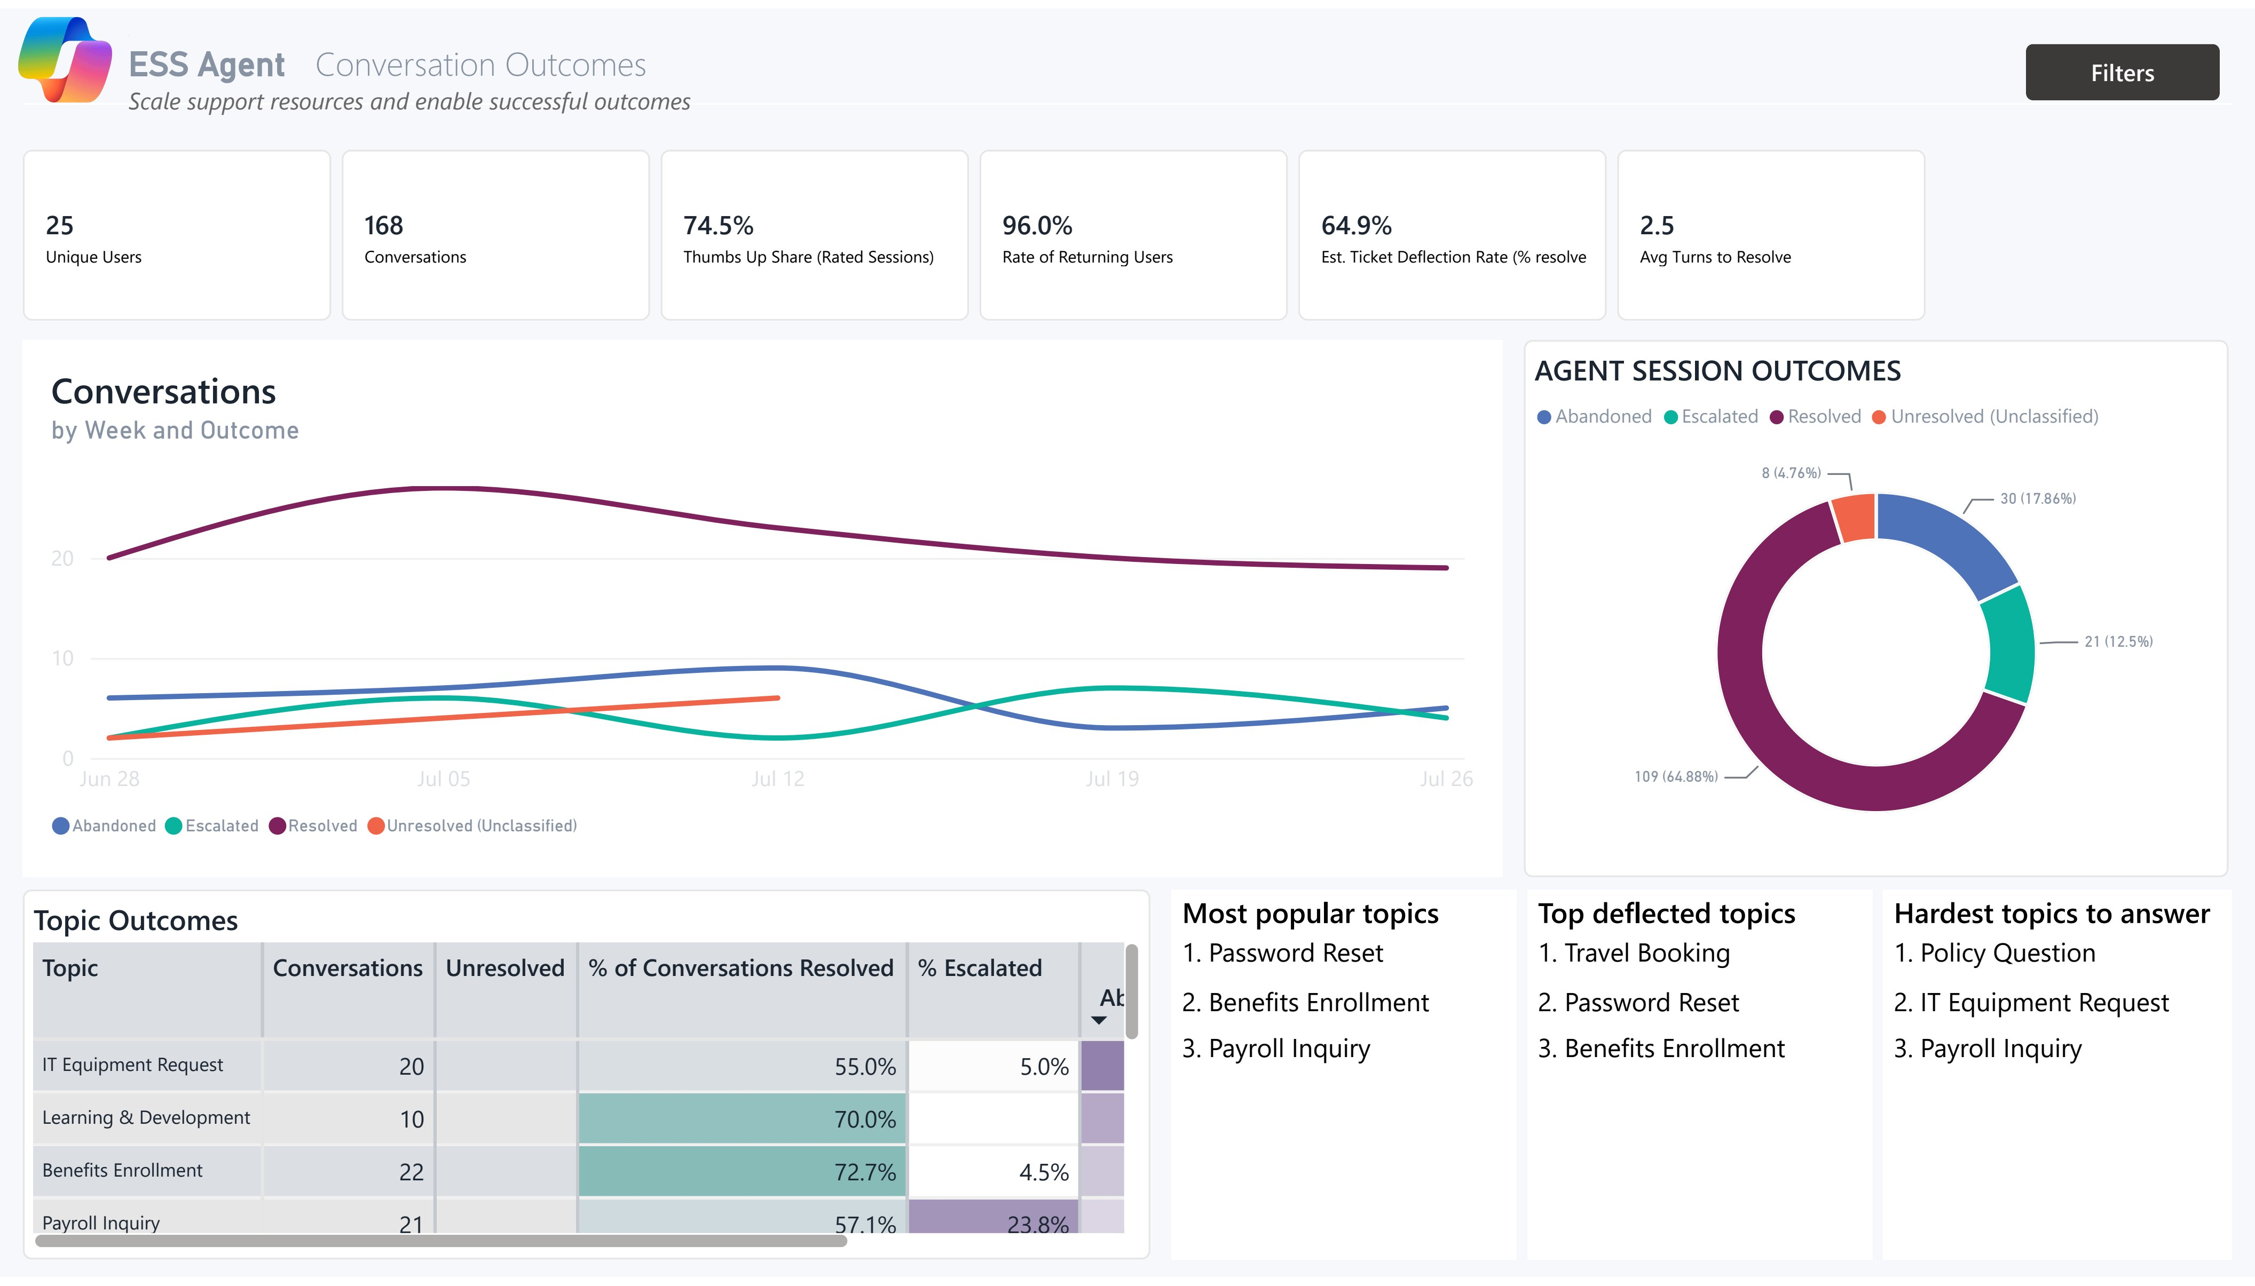
Conversation Outcomes What actually happens in a conversation
1
How often does the agent fully resolve the request?
INTERPRETATION: Resolution Rate is now the headline effectiveness number — the share of real conversations resolved without a human. When resolution sits in the high 50s or low 60s, that converts directly to cost savings; Engaged Rate shows how many conversations had genuine back-and-forth.
RECOMMENDATION: Anchor your ROI story to Resolution Rate. A few points of improvement is usually the biggest single lever on the Business Impact page.
1
2
3
2
What is the mix of outcomes?
INTERPRETATION: Agent Session Outcomes shows resolved vs. escalated vs. unresolved. A large escalated slice means the agent is triaging, not solving.
GUIDANCE: Track the resolved slice week over week. Shifts in the donut are your earliest warning that content or model quality changed.
4
3
4
Is quality holding as volume grows?
INTERPRETATION: Conversations by Week & Outcome shows whether success holds as usage scales. Rising volume with rising failures means scaling a problem.
RECOMMENDATION: If failures climb with volume, pause expansion and fix content before onboarding more users.
Which topics deflect well, and which are hardest?
INTERPRETATION: The Topic Outcomes table plus the most-popular, top-deflected and hardest lists tell you exactly where the agent wins and struggles.
RECOMMENDATION: Promote top-deflected topics in comms to drive volume to proven wins; route the hardest topics into the backlog with named owners.

Slide 16
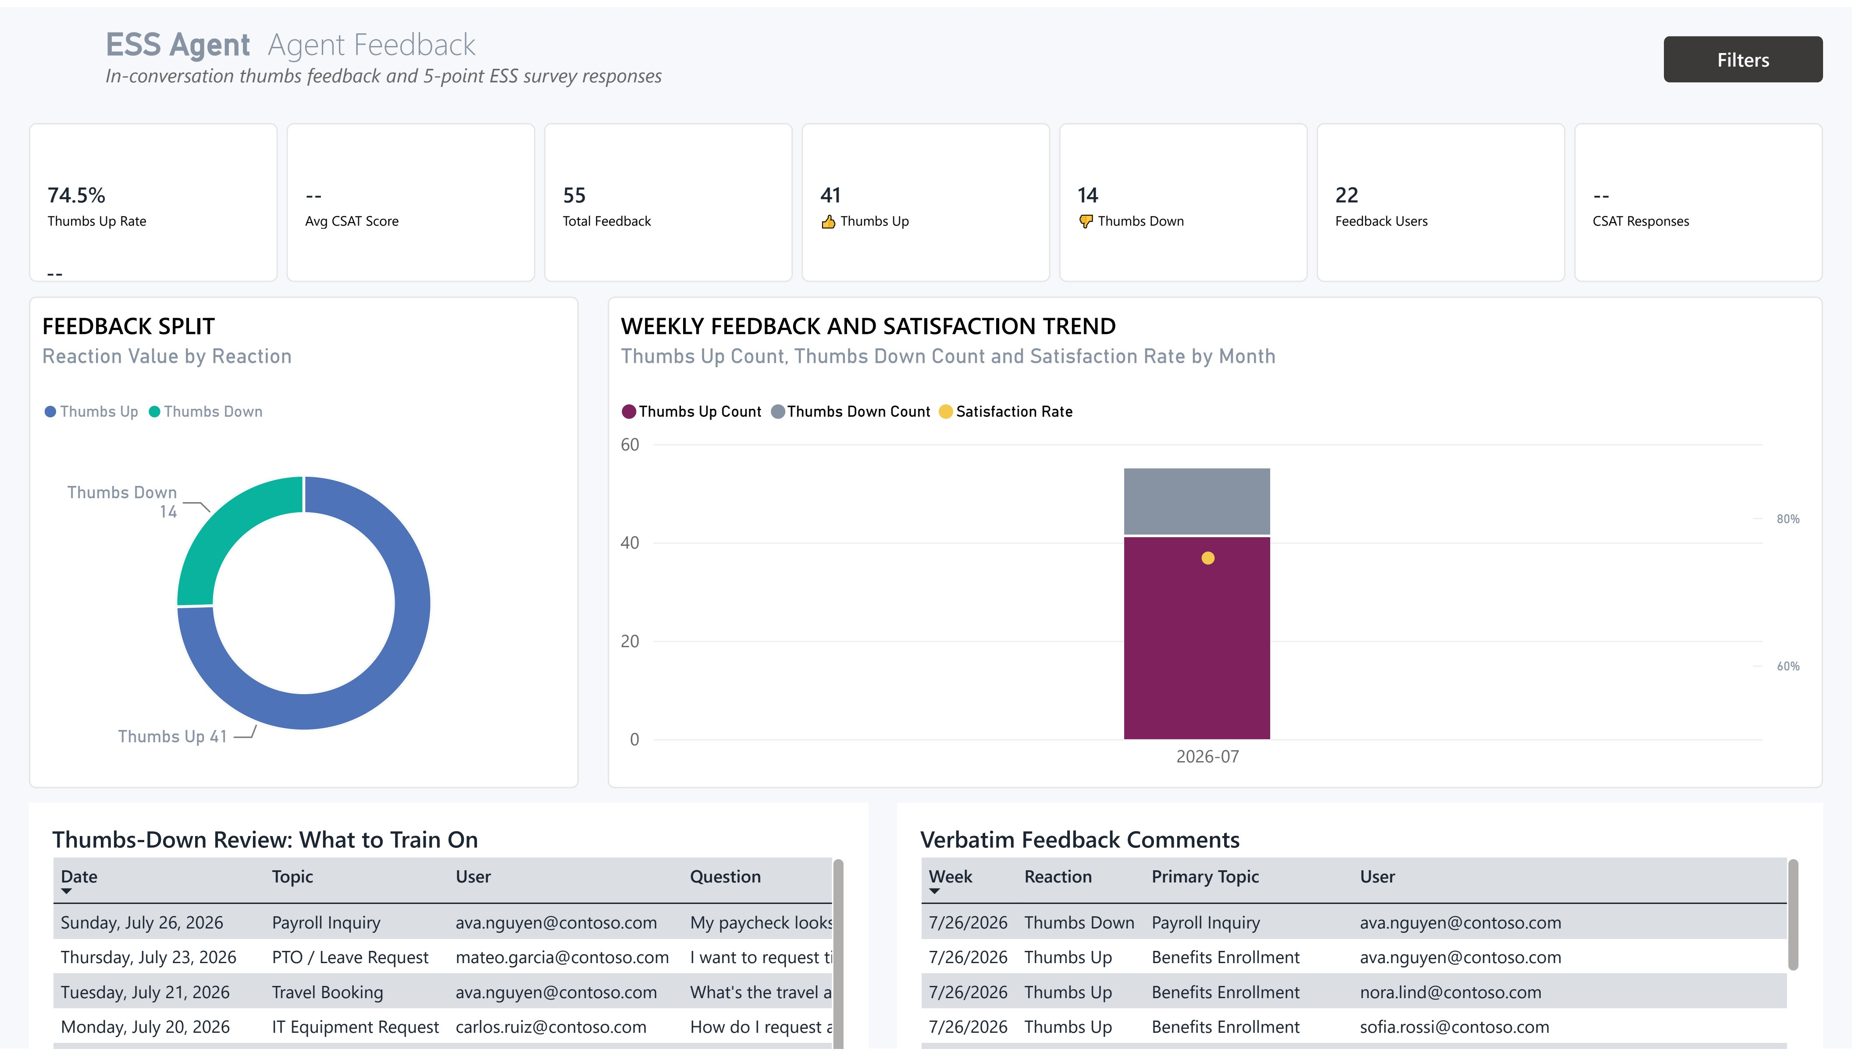
Agent Feedback Do users trust the answers?
1
Do users actually trust the answers?
INTERPRETATION: Satisfaction shows "Not yet captured" until a feedback export is connected — at that point Thumbs-Up Rate and CSAT populate as your sentiment signals. Positive Feedback is tracked as its own KPI in the meantime, so you always have a trust signal even before a full feedback pipeline is wired up.
RECOMMENDATION: Watch response coverage as well as score once feedback is connected. A great score from a tiny sample isn't proof; prompt for feedback to make the number trustworthy.
1
3
2
Is satisfaction improving as you iterate?
INTERPRETATION: The Weekly Feedback & Satisfaction trend ties sentiment to your release cadence. It should climb after each content or prompt improvement.
GUIDANCE: Annotate this trend with your change log. A dip after a change is a fast, cheap signal to roll back or fix.
2
4
3
4
Which topics delight, and which frustrate?
INTERPRETATION: Thumbs-Up % by Top Topic pinpoints low sentiment even where volume is high. A popular topic with low thumbs-up is a high-impact fix.
RECOMMENDATION: Cross-reference low-sentiment topics with the hardest topics on Conversation Outcomes — overlaps are your top-priority content work.
What are users telling you in their own words?
INTERPRETATION: Verbatim Feedback Comments are the qualitative gold — they explain the 'why' behind the scores that numbers alone can't.
GUIDANCE: Read the negatives weekly and theme them. Recurring phrases (wrong answer, couldn't find, too slow) map directly to specific fixes.

Slide 17
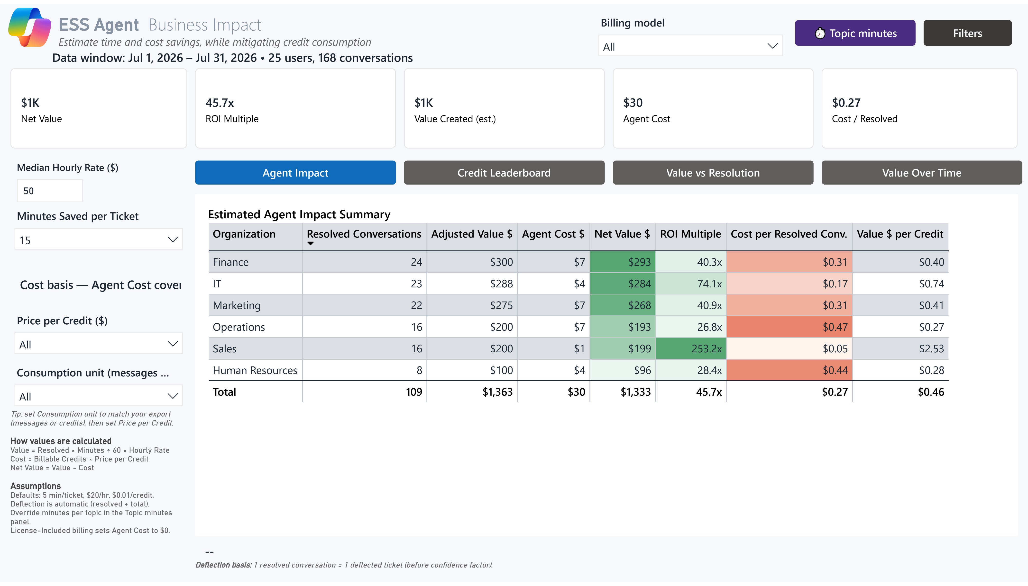
Business Impact What the agent is worth
1
What is the agent worth in hours and dollars?
INTERPRETATION: Tickets Deflected (453), Hours Saved (75.5) and Cost translate usage into business value — the numbers leadership remembers.
RECOMMENDATION: Report net value (hours-saved value minus credit cost), not gross. That's the honest figure that survives finance scrutiny.
1
2
Are the ROI assumptions defensible?
INTERPRETATION: Every value figure depends on the assumptions shown — Median Hourly Rate ($50) and Minutes per Ticket (15). Change them and ROI changes proportionally.
RECOMMENDATION: Replace the demo assumptions with your organization's agreed numbers before sharing externally, and get finance to sign off once. See the companion deck Topic to Time Savings for how to source these minutes from your own ITSM and HR records, and how to document the sign-off.
2
3
4
3
4
Where is value concentrated?
INTERPRETATION: The Estimated Agent Impact Summary breaks value down so you can see which topics or agents drive the savings.
GUIDANCE: Double down on the high-value areas and question the low-value, high-cost ones — not every use case earns its credits.
Is spend proportional to value?
INTERPRETATION: The Credit Consumption Leaderboard shows where credits go. High consumption is fine if it maps to high deflection; high spend with low deflection is waste.
RECOMMENDATION: Review top consumers monthly against their deflection and rebalance any agent that burns credits without returning value.

Slide 18
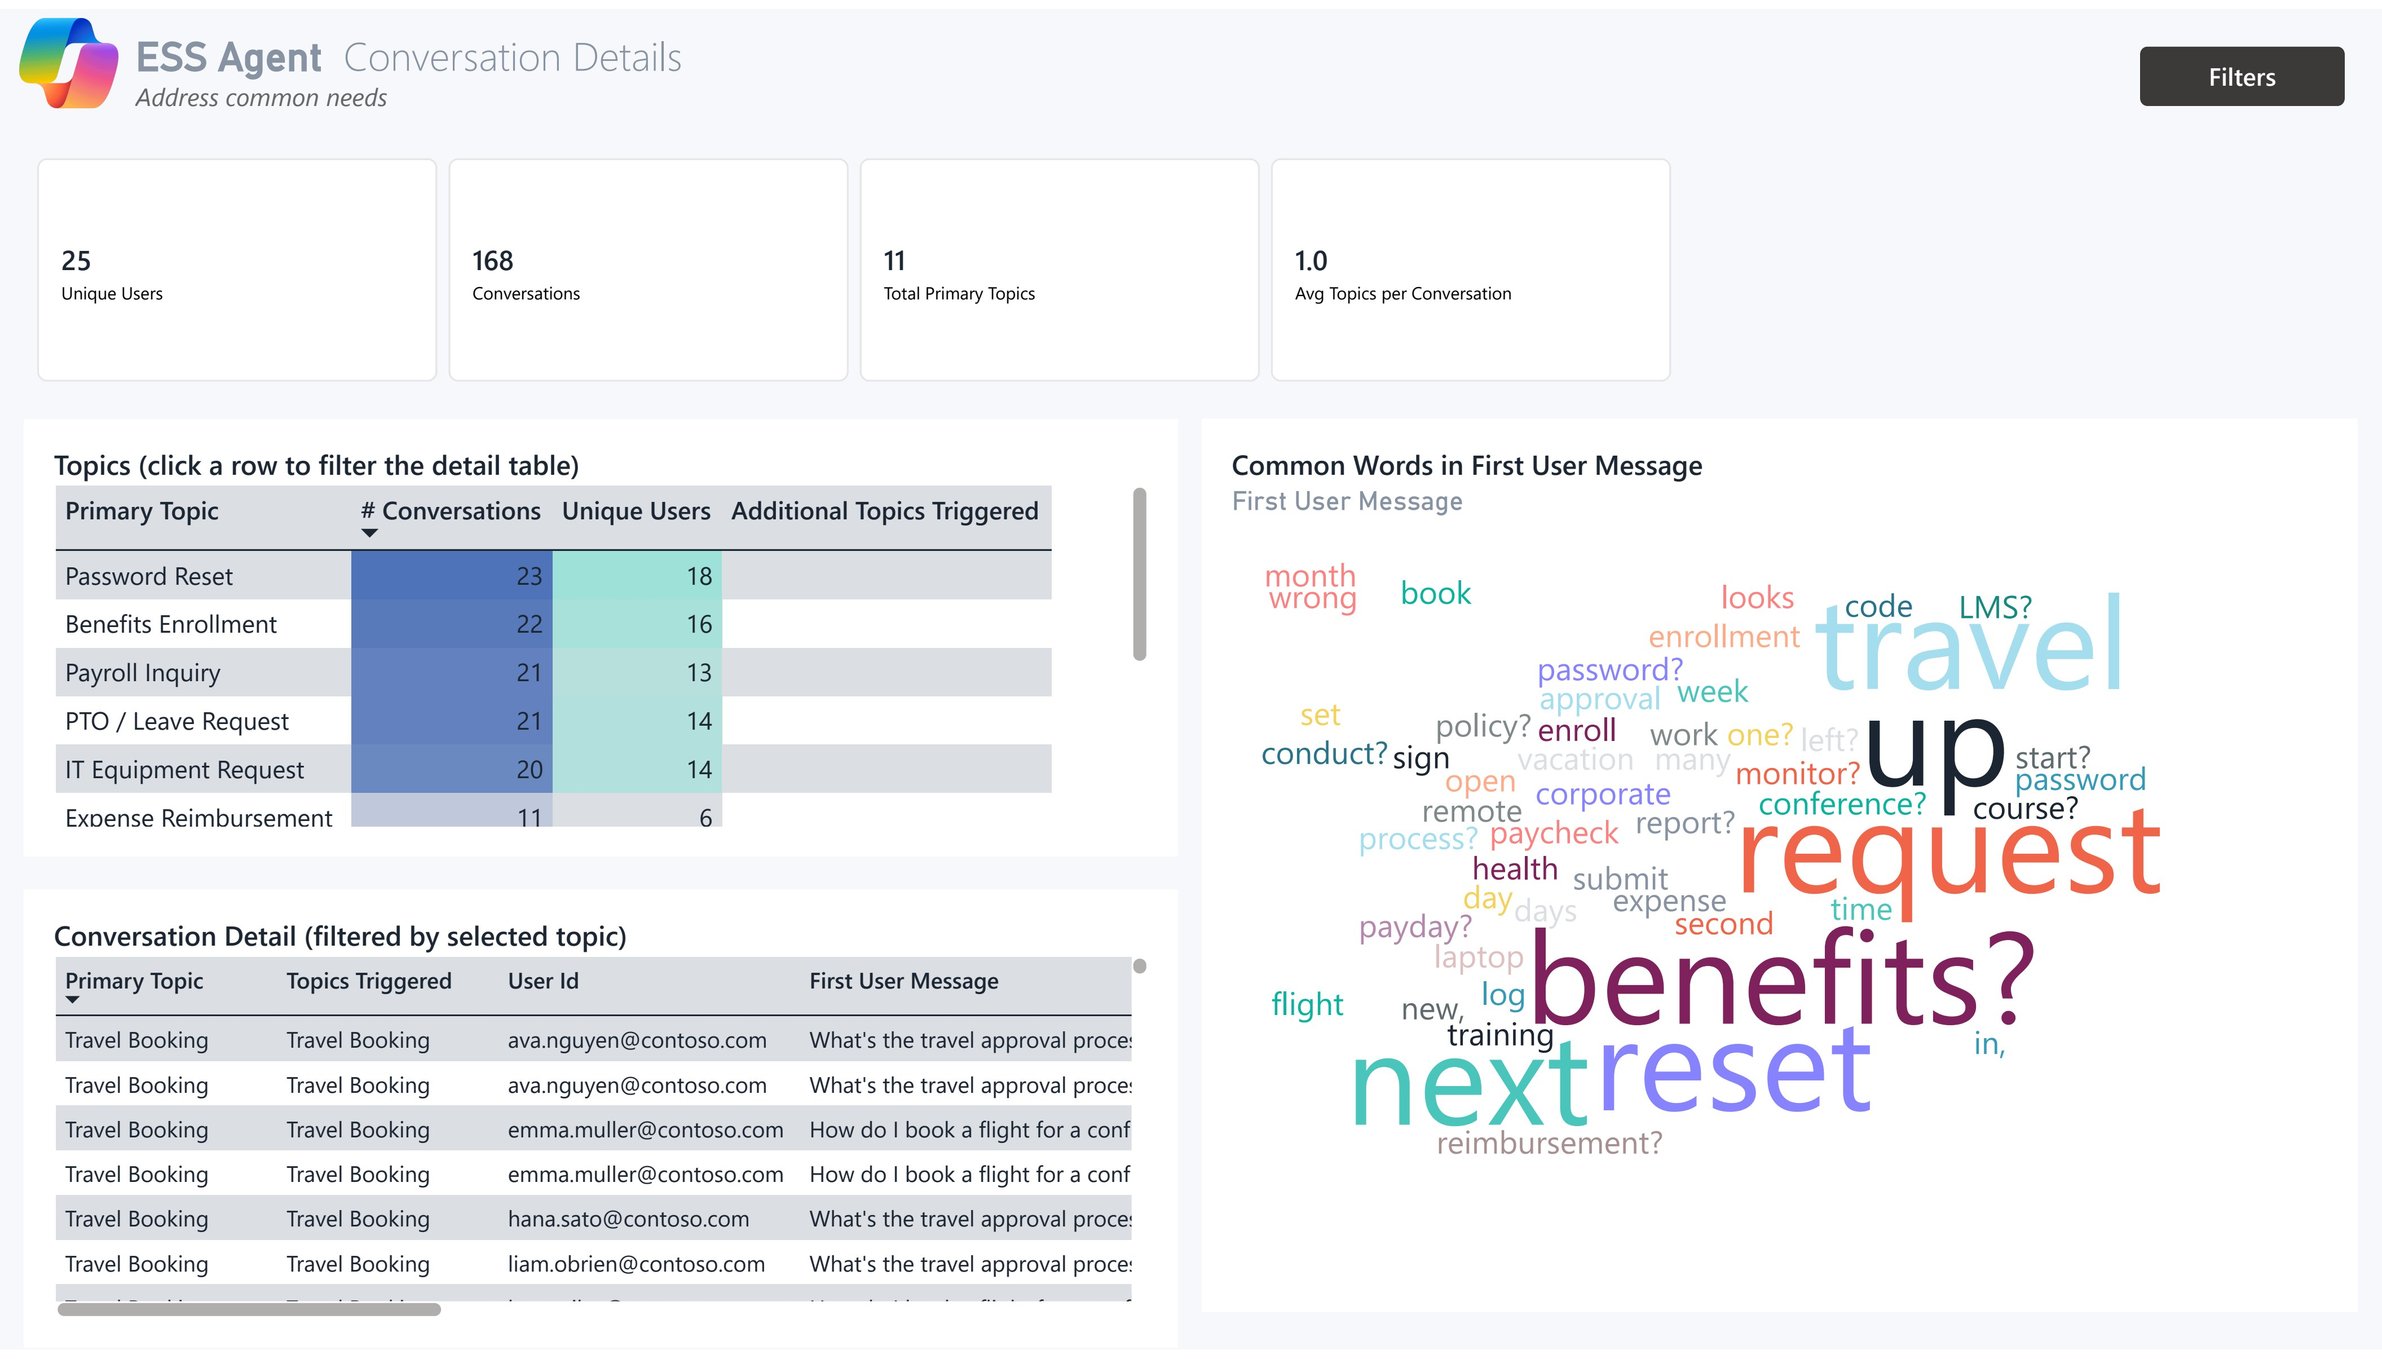
Conversation Details The evidence behind the metrics
1
How broad is the demand on the agent?
INTERPRETATION: 56 Primary Topics with 1.3 topics per conversation means users arrive with focused, single-intent questions across a wide subject range.
GUIDANCE: A wide topic spread means broad relevance; a narrow one means a point solution. Know which you have when planning content.
1
2
2
3
Which subjects actually drive volume?
INTERPRETATION: The Topics table is your interactive entry point — click a topic to filter the whole page. The top rows are where content investment pays off most.
RECOMMENDATION: Run a topic-by-topic content review starting at the top of the volume list; that's where a single fix touches the most users.
4
3
4
Can I see what really happened in a conversation?
INTERPRETATION: The Conversation Detail table is the transcript-level evidence behind every aggregate metric — where you validate that 'resolved' truly resolved.
GUIDANCE: When a metric looks too good or too bad, drill here first. Real transcripts settle debates that dashboards start.
What language do users actually use?
INTERPRETATION: Common Words in the first user message reveals real user vocabulary — the phrasing your content and prompts must match.
RECOMMENDATION: Align article titles, synonyms and trigger phrases to this language. Matching user words is the cheapest way to cut zero-result rates.

Slide 19
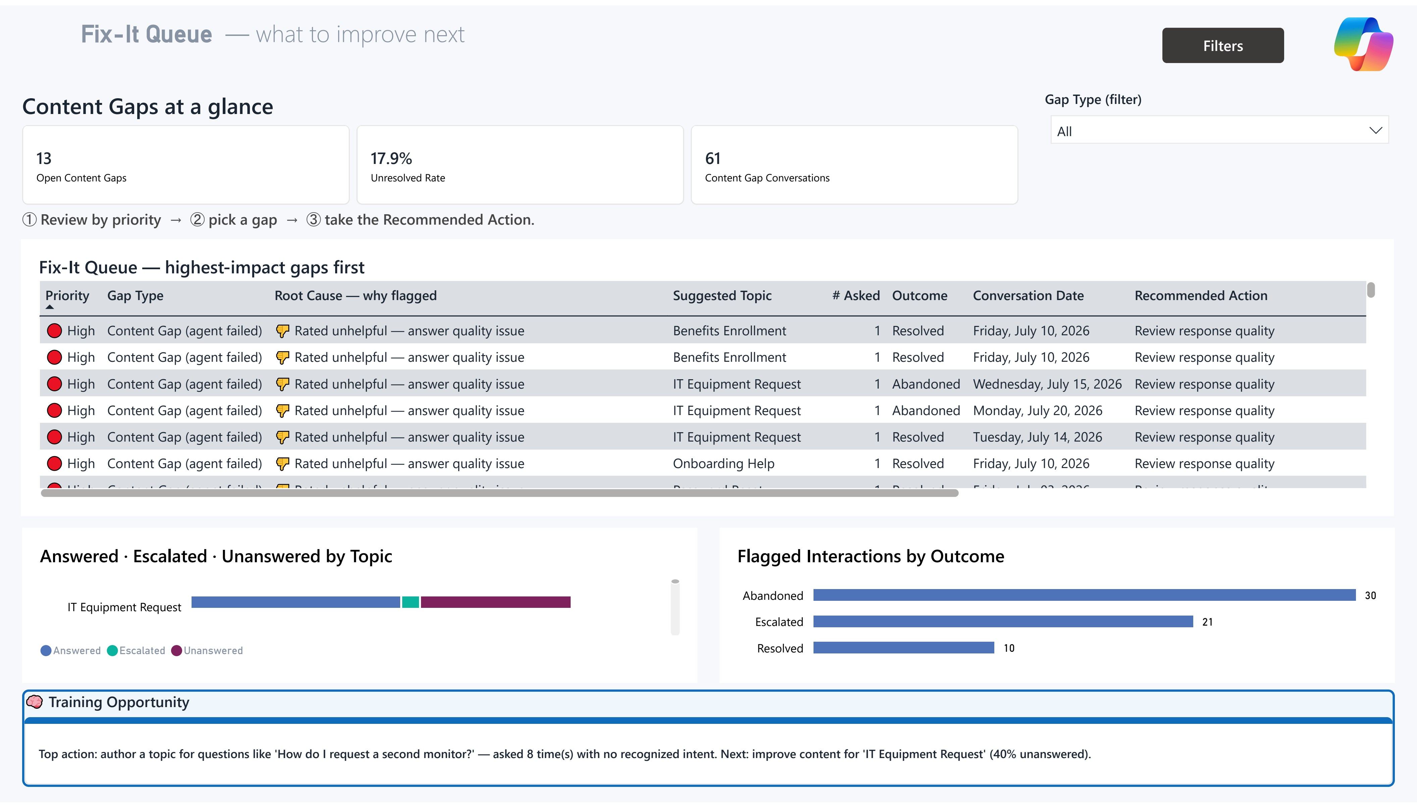
Fix-It Queue What to improve next
1
Where is the agent failing users right now?
INTERPRETATION: Open Content Gaps, Unresolved Rate and Content Gap Conversations quantify the backlog of real failures the agent has not yet resolved — the gap between what users ask and what the agent can answer.
RECOMMENDATION: Treat this backlog as the agenda for your content team. Each Content Gap you close is a direct gain to Resolution Rate and satisfaction.
1
3
2
Which topics need content work first?
INTERPRETATION: Content Gap vs Authoring Gap is the key distinction — not every flagged row is a failure. A Content Gap means the agent genuinely failed (no answer path, unhelpful rating, or escalation); an Authoring Gap means the agent resolved the question generatively but no native topic exists yet — the employee was already helped, and this is optional cleanup, not real work.
GUIDANCE: Default the Gap Type filter to Content Gap so genuine failures come first. Rank those by Priority and assign the top rows to owners this sprint.
2
4
3
4
What does each row in the queue actually mean?
INTERPRETATION: Root Cause explains WHY a row was flagged, in plain language. Recommended Action says what to do about it. Priority ranks rows by frequency and severity, so the top of the table is always the highest-leverage fix.
GUIDANCE: Work the queue top to bottom. It's the dashboard telling you where one fix buys the most value.
What are we missing entirely?
INTERPRETATION: The 'No Topic Detected' table lists real questions the agent couldn't even categorize — pure whitespace, each with a recommended action.
RECOMMENDATION: Work this table row by row. These are net-new content or routing opportunities that expand what the agent can do, not just how well.

